Slide 1
Computational Physics
(Lecture 12)
PHY4061

Slide 2
Empirically, autocorrelation time grows proportional to the power of correlation Length. In the case of MC, t_{c} =c L^{z}.
Here, z is about 2.
The Swendsen and Wang approach (1987).
  The block update scheme: based on the nearest neighbor pair picture of the Ising model
  the partition function is a result of the contributions of all the nearest pairs of sites in the system.

Slide 3
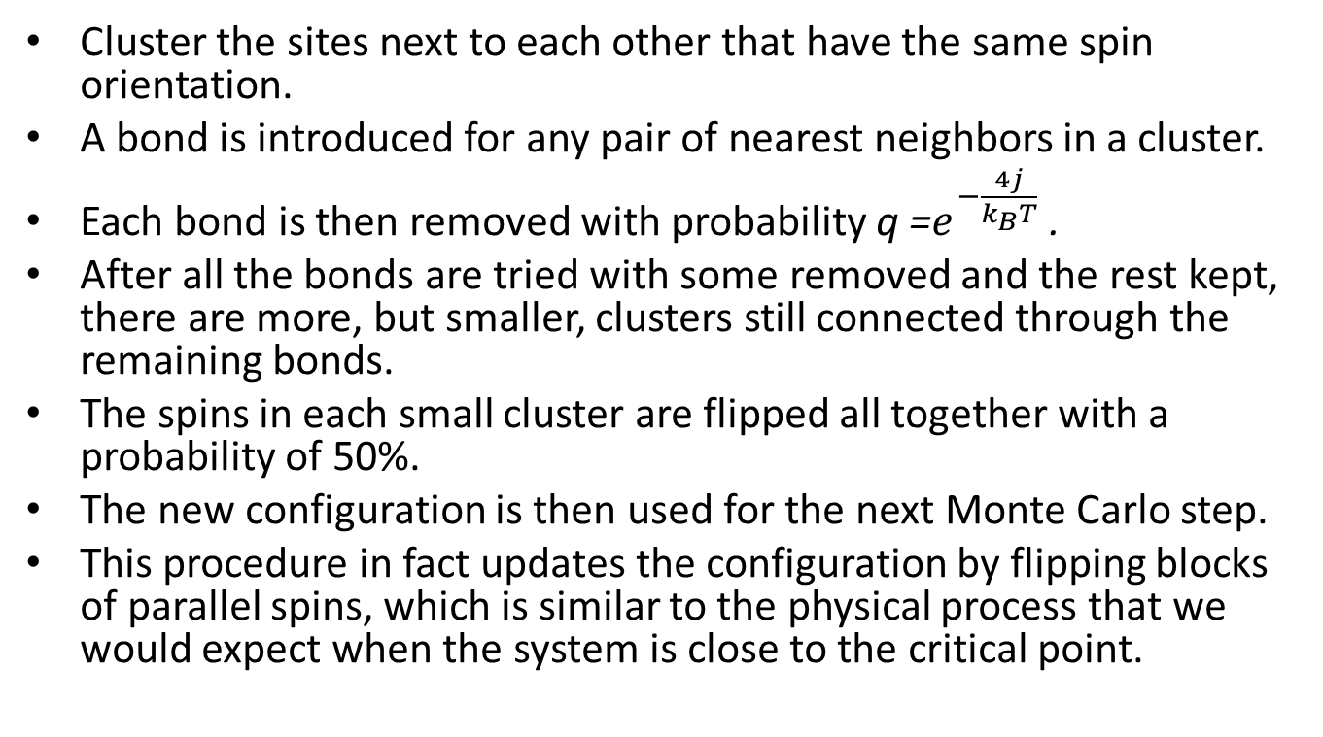
Summary of the algorithm
Cluster the sites next to each other that have the same spin orientation.
A bond is introduced for any pair of nearest neighbors in a cluster.
Each bond is then removed with probability q =$e^{−\frac{4j}{k_{B}T}}$ .
After all the bonds are tried with some removed and the rest kept, there are more, but smaller, clusters still connected through the remaining bonds.
The spins in each small cluster are flipped all together with a probability of 50%.
The new configuration is then used for the next Monte Carlo step.
This procedure in fact updates the configuration by flipping blocks of parallel spins, which is similar to the physical process that we would expect when the system is close to the critical point.

Slide 4
The speedup in this block algorithm is extremely significant.
Numerical simulations show that the dynamical critical exponent is significantly reduced, with z =0.35 for the two-dimensional Ising model and z =0.53 for the three dimensional
Ising model, instead of z = 2 in the spin-by-spin update scheme.

Slide 5
Wolff Algorithm
S-W does not eliminate the critical slowing down completely.
Wolff Algorithm, greatly improve the 3D Ising model. In 4D, z is approaching to 0!

Slide 6
Instead of removing bonds, Wolff proposed constructing a cluster in which the nearest sites have the same spin orientation.
Select a site randomly from the system and add its nearest neighbors with the same spin orientation to the cluster with the probability p = 1 − q.
All the spins in the constructed cluster are then flipped together to reach a new spin configuration of the system.

Slide 7
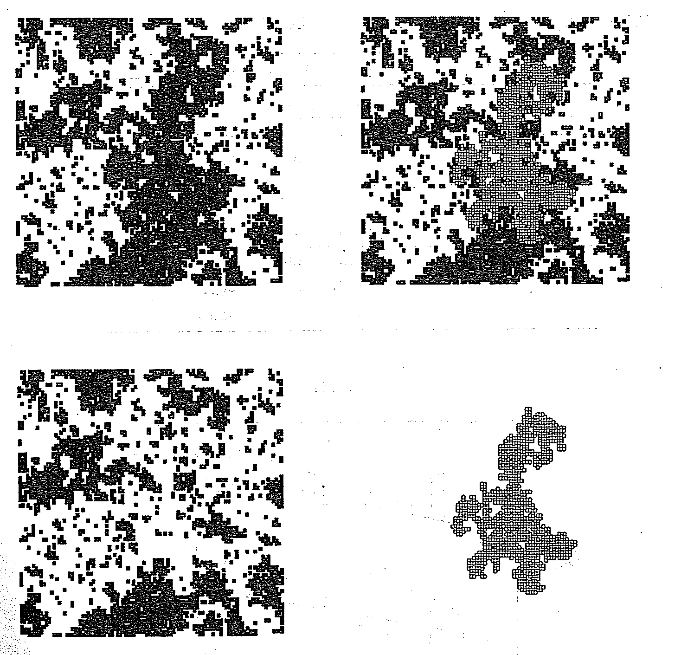

Slide 8
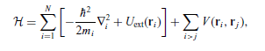
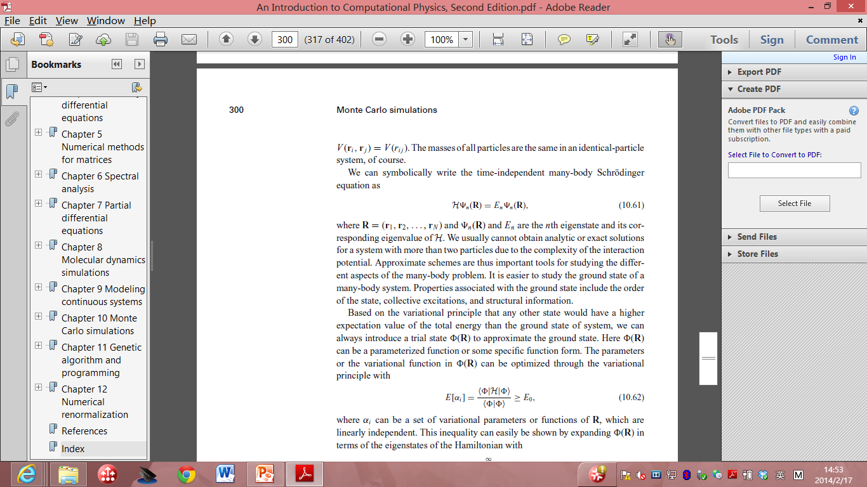
Variation quantum Monte Carlo
the approximate solution of the Hamiltonian
Time Independent many-body Schrodinger’s equation:

Slide 9
We cannot obtain analytic or exact solutions for a system with more than two particles due to the complexity of the interaction potential.
Approximation is important.
One of the most important problems:
  Ground state properties.

Slide 10
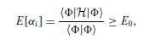
Based on the variational principle
  introduce a trial state φ(R) to approximate the ground state.
Here φ(R) can be a parameterized function or some specific function form.
The parameters or the variational function in φ(R) can be optimized through the variational
principle with
α_{i} : parameters or
functions of R

Slide 11
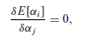
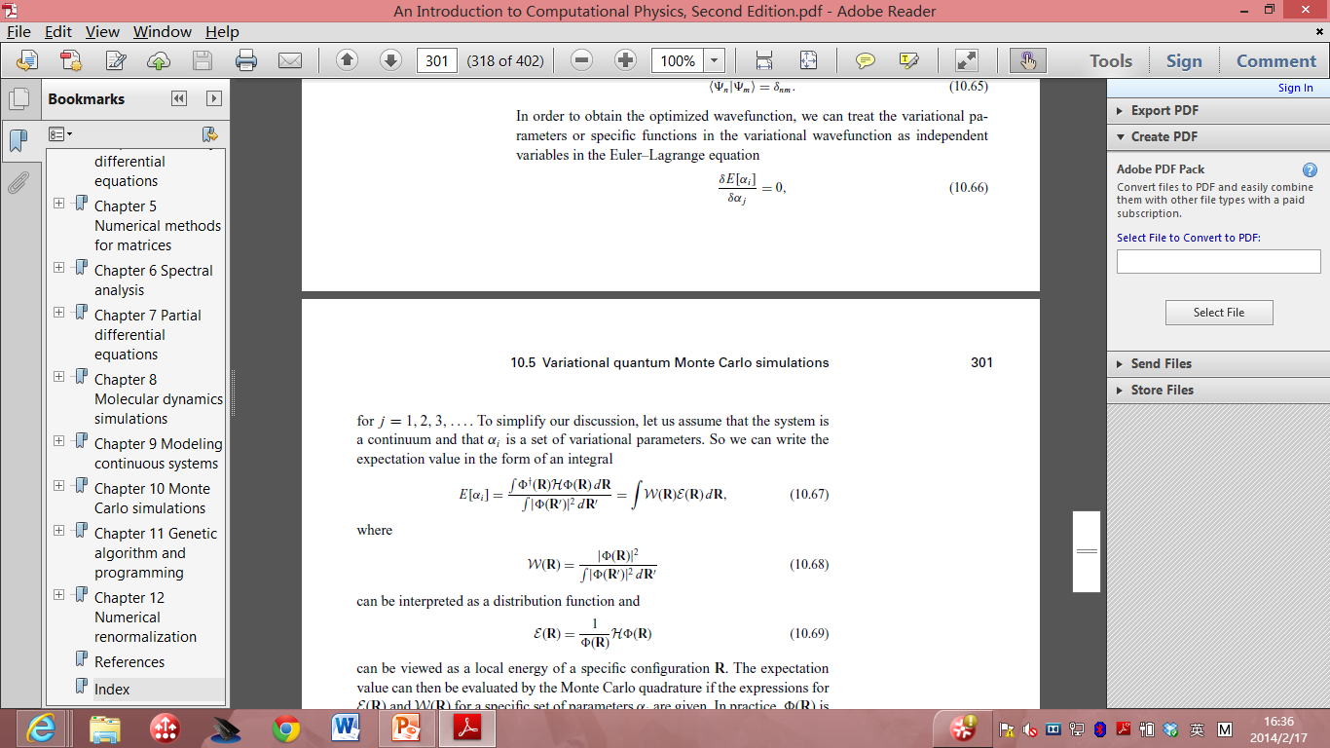
Treat the α_{i} as independent variables in Euler_Lagrange equation:
Distribution function, sample it.
Evaluate E as the average of Local energy of the configuration R

Slide 12
The expectation value of energy can be evaluated using MC if we have the forms of both functions.
Important to include physics in φ(R) , then take the variation process.

Slide 13
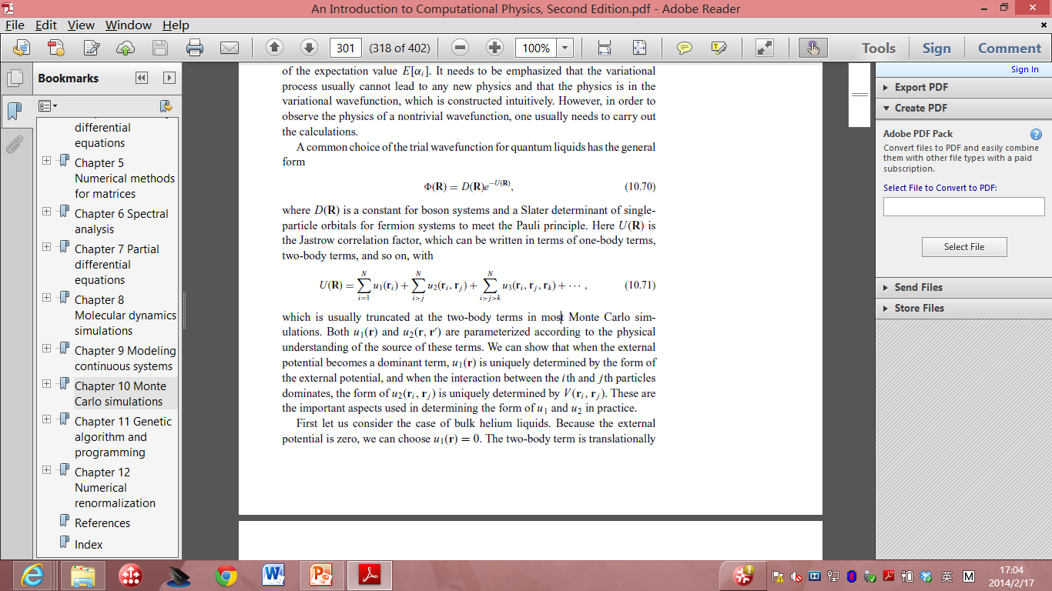
For quantum liquids:
D(R): a constant for boson systems and a Slater determinant of single particle orbitals for fermion systems to meet the Pauli principle.
Here U(R) is the Jastrow correlation factor, which can be written in terms of one-body terms, two-body terms, and so on, with

Slide 14
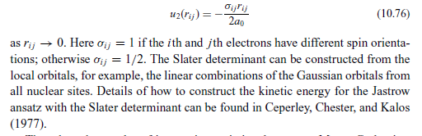
The electronic systems.
  Atomic, molecular and solids system.
  u₁(r)= Z r/a₀ (a₀ is the Bohr radius)

Slide 15
for the statistical system the calculations are done for a given temperature, but for the quantum system they are done for a given set of variational parameters in the variational wavefunction.
We can update either the whole configuration or just the coordinates associated with a particular particle at each Metropolis step.

Slide 16
Kinetic Monte Carlo
Intended to simulate the time evolution of some processes occurring in nature.
Predetermined or known rate of the processes.
Used widely in
  Surface diffusion. Surface growth. Defects diffusion. Coarsening of domain evolution….

Slide 17
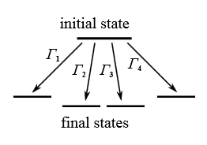


Slide 18
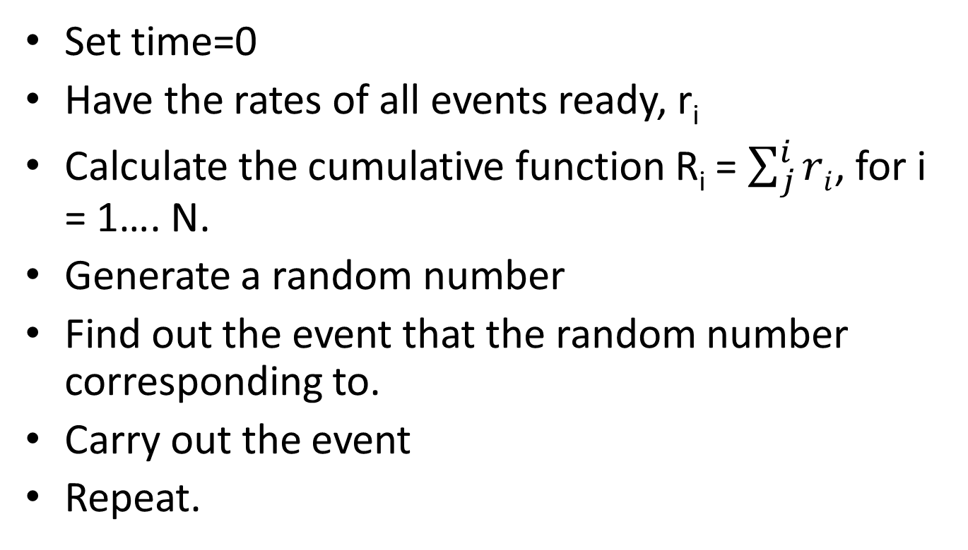
Algorithm
Set time=0
Have the rates of all events ready, r_{i}
Calculate the cumulative function R_{i} = $\sum_{j}^{i}{ri}$, for i = 1…. N.
Generate a random number
Find out the event that the random number corresponding to.
Carry out the event
Repeat.

Slide 19
Note, it’s also possible to treat the simulation step non-uniformly by generating another random number, and the delta t = ln(1/rand)/ R_N.
Events generation rates can also be time dependent.
Good to simulate non-equilibrium process.

Slide 20
To simulate surface diffusions
Define Γ as the hopping rate, γ is the vibrational frequency, Ed is the diffusion barrier
Γ = γ exp(-Ed/k_{B} T)
So if you know γ, T, and Ed, the diffusion can be simulated using a random number generator.

Slide 21
Iterative function system
MC is also used in fractal studies.
Method to construct fractals.
For example:
  We have three points A, B, C (not on the same line) and three probabilities, PA, PB and PC.
  Throw the dice, generate a point Z, following:
  Z_{n+1} = (Z_{n} + A )/2, under PA, (Z_{n} + B)/2, under PB, (Z_{n} + C)/2, under PC.

Slide 22
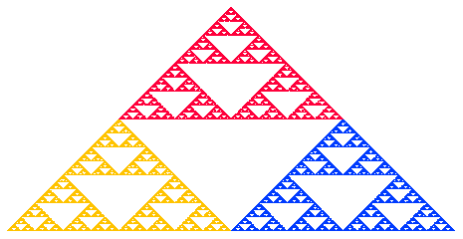

Slide 23
Randomly choose which point to plot.
Good to simulate biological systems.

Slide 24
Monte Carlo in Finance
Risk Neutral measure
Instead of first taking the expectation and then adjusting for an investor's risk preference,
one can adjust, once and for all, the probabilities of future outcomes
such that they incorporate all investors' risk premia, and then take the expectation under this new probability distribution, the risk-neutral measure.

Slide 25
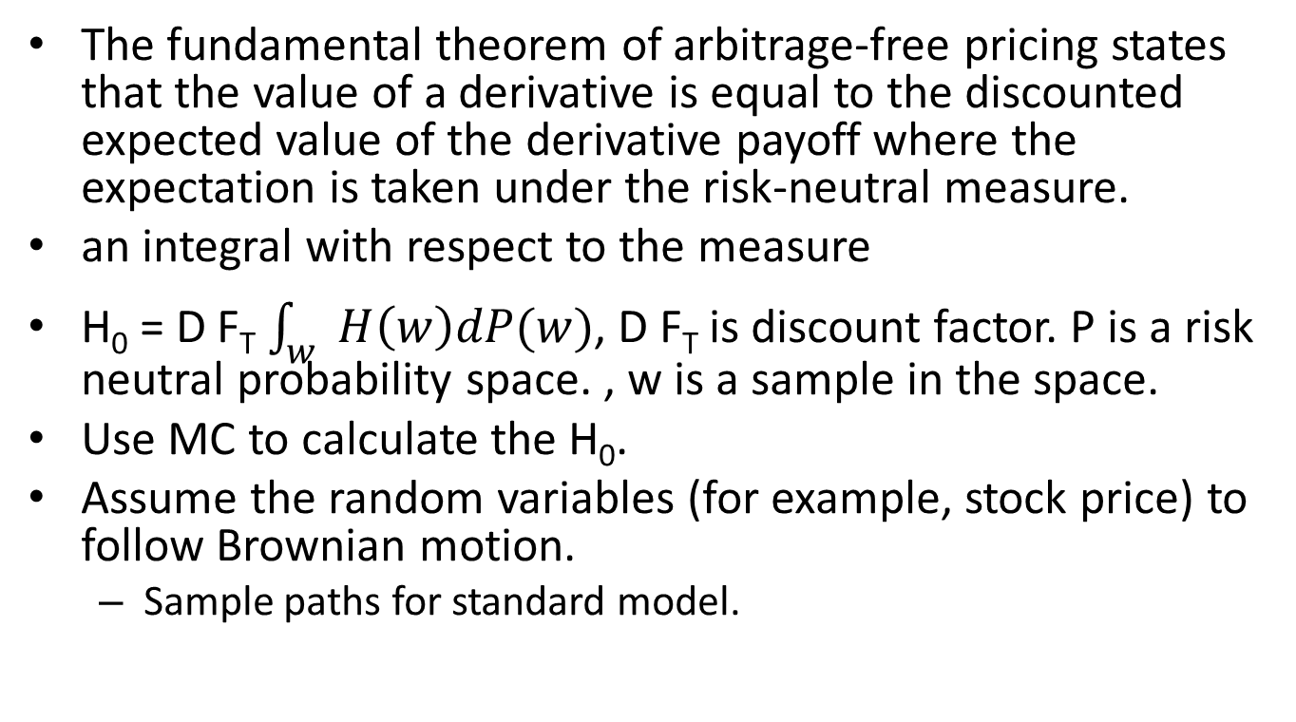
Monte Carlo in Finance
The fundamental theorem of arbitrage-free pricing states that the value of a derivative is equal to the discounted expected value of the derivative payoff where the expectation is taken under the risk-neutral measure.
an integral with respect to the measure
H₀ = D F_{T} $\int_{w}{H\left(w\right)dP(w)}$, D F_{T} is discount factor. P is a risk neutral probability space. , w is a sample in the space.
Use MC to calculate the H₀.
Assume the random variables (for example, stock price) to follow Brownian motion.
  Sample paths for standard model.

Slide 26
Ordinary differentiation equation
Most problems in physics and engineering appear in the form of differential equations.
  the motion of a classical particle is described by Newton’s equation

Slide 27
Initial-value problems
initial-value problems involve dynamical systems,
  for example, the motion of the Moon, Earth, and the Sun,
  the dynamics of a rocket, or the propagation of ocean waves.

Slide 28
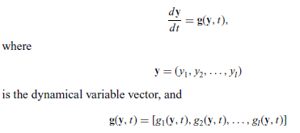
Generalized velocity vector.

Slide 29
In principle, we can always obtain the solution of the above equation set if the initial condition y(t = 0) = y₀ is given and a solution
exists.

Slide 30
the particle moving in one dimension under an elastic force:
  f = ma,
i = 2: that is, y₁ = x and y₂ = v = dx/dt,
and g₁ = v = y₂
and g₂= f/m = −kx/m = −ky₁/m.
dy₁/dt = y₂,
dy₂/dt= −k y₁/m
If y₁(0) and y₂(0) are given, we can solve it numerically.

Slide 31
Most high order differential equations can be transformed into a set of coupled first-order differential equations.
The higher order derivatives are usually redefined into new dynamical variables during the transformation.

Slide 32
Project A part 4
Write a subroutine of Steepest Decent and Conjugate Gradient method for minimization of total energy. Test these methods by randomly displacing atoms (very small displacements) in LJ (50%) based crystal and the crystal structure of your choice in part 4, and then relaxing the atoms to their equilibrium positions. Plot the starting and the ending positions of your crystal structures using VMD. You may get 10% bonus if you implement CG in SW/Tersoff or EAM potentials, but your total score is capped at 100%

